Slide 1
Database Systems
Lab 10
Connectivity: PHP with MYSQL

Slide 2
All in ONE
Web Server - XAMPP - APACHE
PHP – (7.1.10: LATEST)
Database ( MY-SQL)
Text Editor ( Notepad++ , PHPSTORM, etc)
Web browser (CHROME, Internet Explorer, etc)

Slide 3
MySQL?
MySQL is a database system used on the web
MySQL is a database system that runs on a server
MySQL is ideal for both small and large applications
MySQL is very fast, reliable, and easy to use
MySQL uses standard SQL
MySQL compiles on a number of platforms
MySQL is free to download and use
MySQL is developed, distributed, and supported by Oracle Corporation

Slide 4
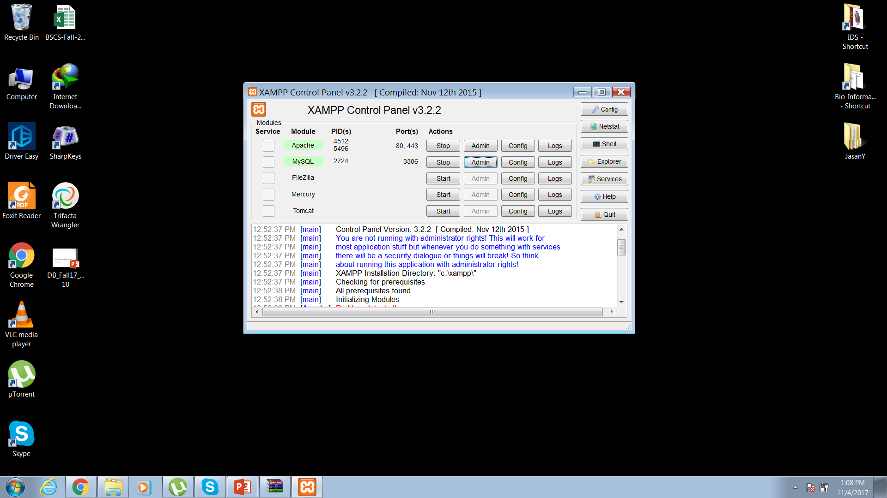
XAMPP – Control Panel

Slide 5
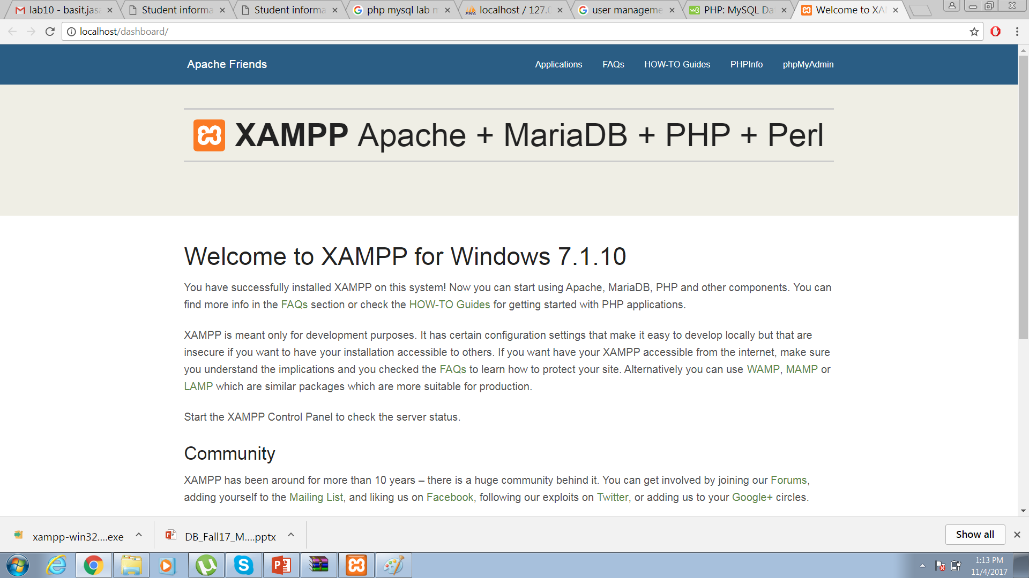
Apache – Admin Console

Slide 6
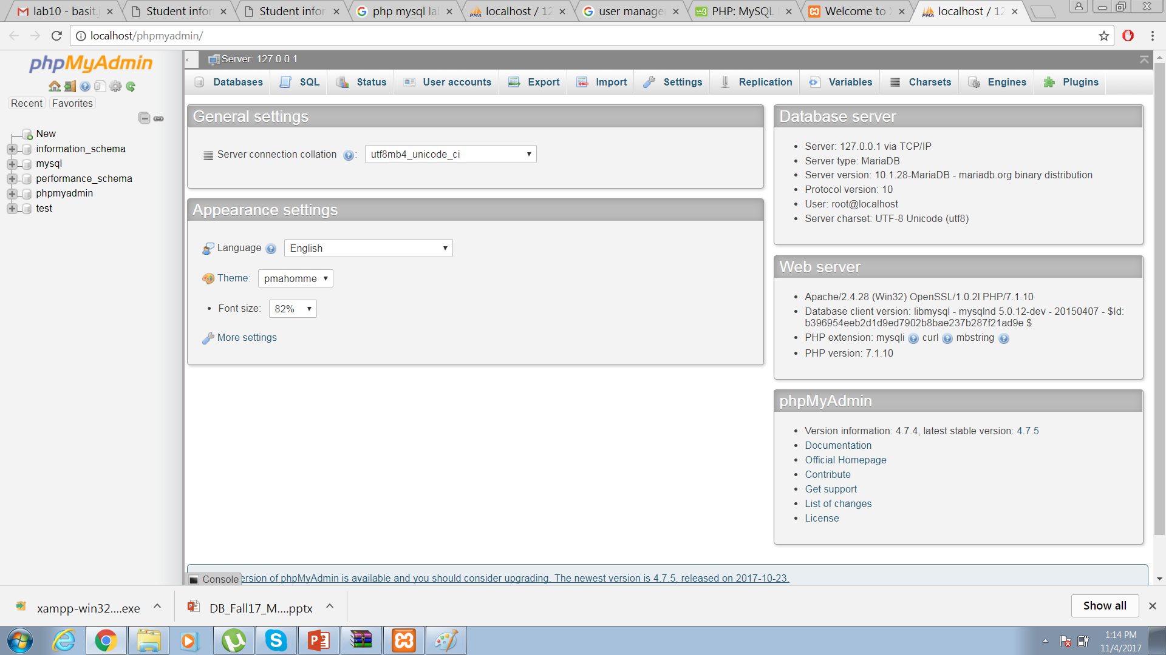
MySQL – PHYmyAdmin Panel

Slide 7
PHP Connection to MYSQL
Before we can access data in the MySQL database, we need to be able to connect to the server
<?php
$servername = "localhost";
$username = "root";
//$password = "password";
// Create connection
$conn = mysqli_connect($servername, $username);
// Check connection
if (!$conn) {
die("Connection failed: " . mysqli_connect_error());
}
echo "Connected successfully";
?>

Slide 8
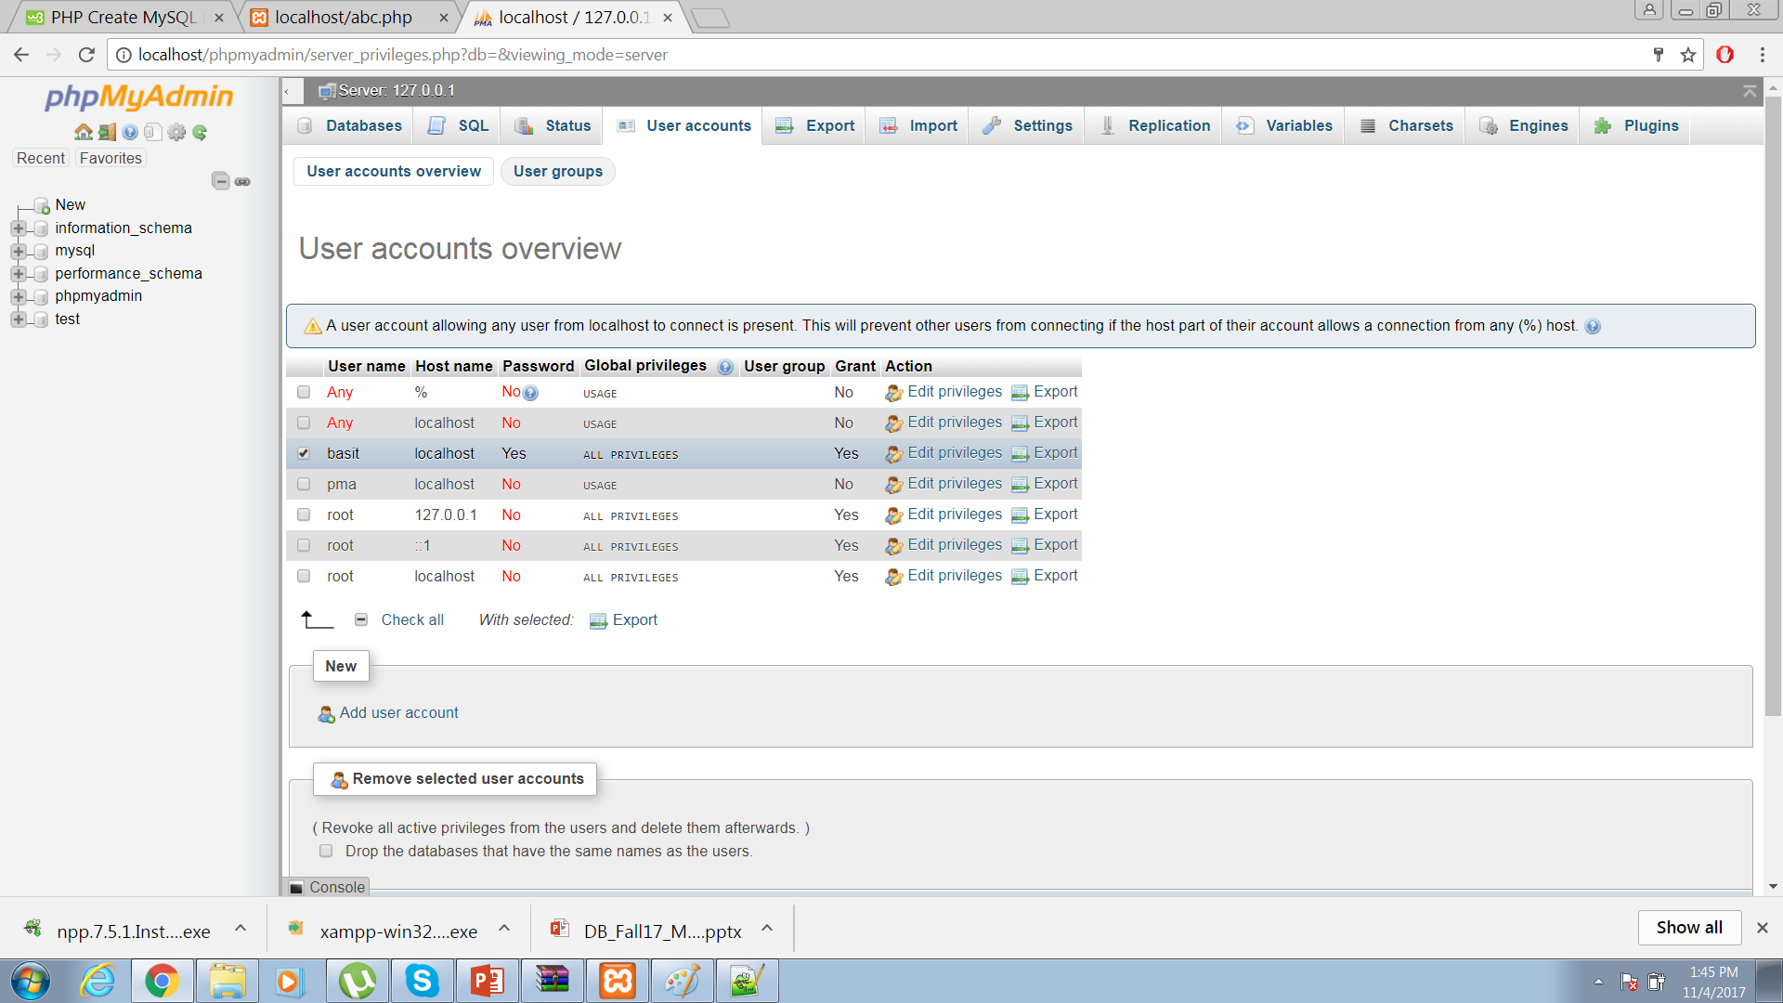
Users? Username? Hostname?

Slide 9
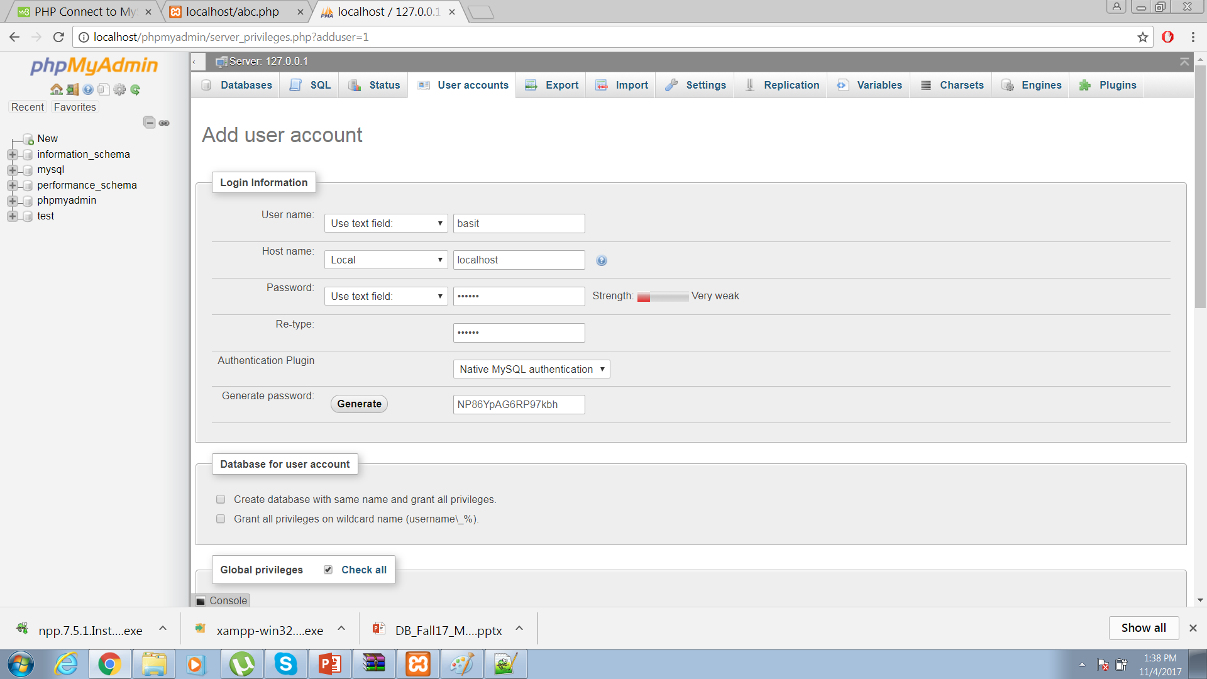
Adding new User

Slide 10
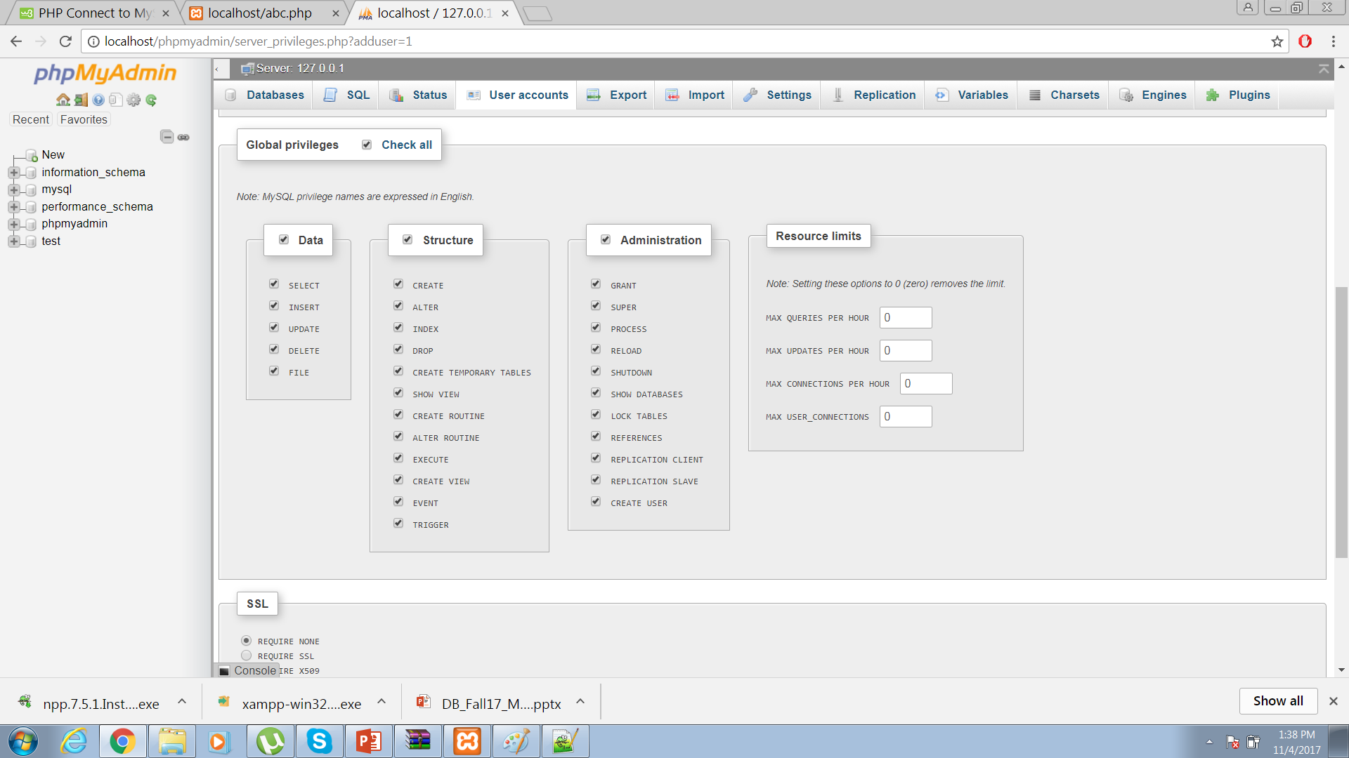
Continue..

Slide 11
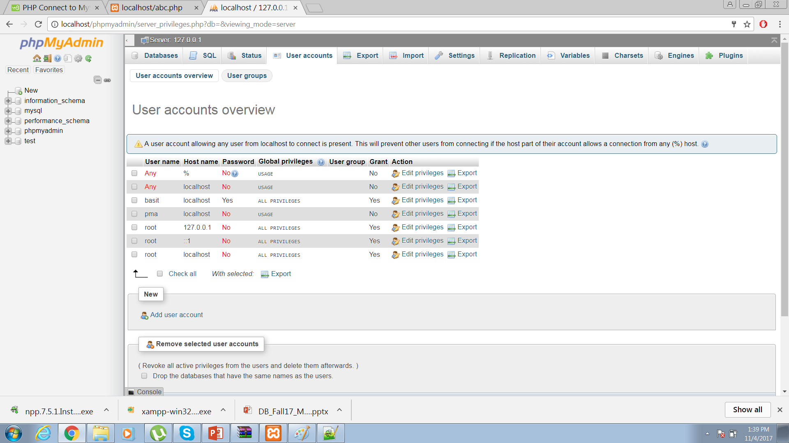
User Added

Slide 12
Creating Database
Two ways
1 – Directly on phyadmin console.
2 - Front end (Text editor)

Slide 13
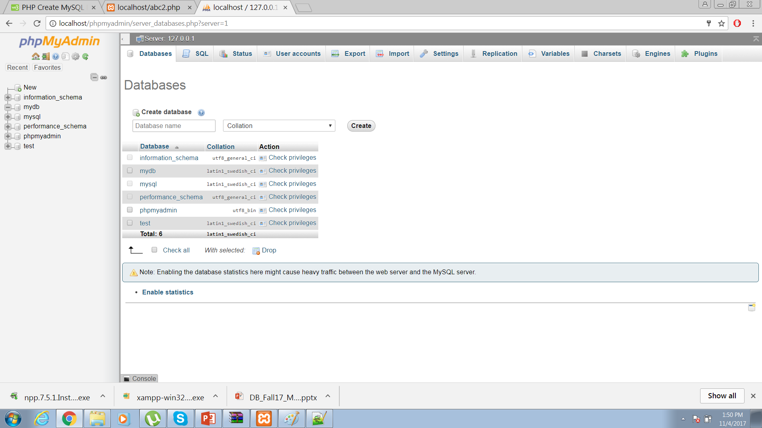
1

Slide 14
2
<?php
$servername = "localhost";
$username = "basit";
$password = "abc123123";
// Create connection
$conn = new mysqli($servername, $username, $password);
// Check connection
if ($conn->connect_error) {
die("Connection failed: " . $conn->connect_error);
}
// Create database
$sql = "CREATE DATABASE myDB";
if ($conn->query($sql) === TRUE) {
echo "Database created successfully";
} else {
echo "Error creating database: " . $conn->error;
}
$conn->close();
?>

Slide 15
Creating Table
Two ways
1 – Directly on phyadmin console.
2 - Front end (Text editor)

Slide 16
1
CREATE TABLE MyGuests ( id INT(6) UNSIGNED AUTO_INCREMENT PRIMARY KEY, firstname VARCHAR(30) NOT NULL, lastname VARCHAR(30) NOT NULL, email VARCHAR(50), reg_date TIMESTAMP )

Slide 17
2
<?php
$servername = "localhost";
$username = "basit";
$password = "abc123123";
$dbname = "myDB";
// Create connection
$conn = new mysqli($servername, $username, $password, $dbname);
// Check connection
if ($conn->connect_error) {
die("Connection failed: " . $conn->connect_error);
}
// sql to create table
$sql = "CREATE TABLE MyGuests (
id INT(6) UNSIGNED AUTO_INCREMENT PRIMARY KEY,
firstname VARCHAR(30) NOT NULL,
lastname VARCHAR(30) NOT NULL,
email VARCHAR(50),
reg_date TIMESTAMP
)";
if ($conn->query($sql) === TRUE) {
echo "Table MyGuests created successfully";
} else {
echo "Error creating table: " . $conn->error;
}
$conn->close();
?>

Slide 18
Inserting data into table
<?php
$servername = "localhost";
$username = "basit";
$password = "abc123123";
// Create connection $conn = new mysqli($servername, $username, $password, $dbname); // Check connection if ($conn->connect_error) { die("Connection failed: " . $conn->connect_error); } $sql = "INSERT INTO MyGuests (firstname, lastname, email) VALUES ('John', 'Doe', 'john@example.com')"; if ($conn->query($sql) === TRUE) { echo "New record created successfully"; } else { echo "Error: " . $sql . "<br>" . $conn->error; } $conn->close(); ?>

Slide 19
Inserting multiple records
<?php
$servername = "localhost";
$username = "basit";
$password = "abc123123";
$dbname = "myDB";
// Create connection
$conn = new mysqli($servername, $username, $password, $dbname);
// Check connection
if ($conn->connect_error) {
die("Connection failed: " . $conn->connect_error);
}
$sql = "INSERT INTO MyGuests (firstname, lastname, email)
VALUES ('John', 'Doe', 'john@example.com');";
$sql .= "INSERT INTO MyGuests (firstname, lastname, email)
VALUES ('Mary', 'Moe', 'mary@example.com');";
$sql .= "INSERT INTO MyGuests (firstname, lastname, email)
VALUES ('Julie', 'Dooley', 'julie@example.com')";
if ($conn->multi_query($sql) === TRUE) {
echo "New records created successfully";
} else {
echo "Error: " . $sql . "<br>" . $conn->error;
}
$conn->close();
?>

Slide 20
Prepared Statements and Bound Parameters
A prepared statement is a feature used to execute the same (or similar) SQL statements repeatedly with high efficiency.
Prepared statements basically work like this:
Prepare: An SQL statement template is created and sent to the database. Certain values are left unspecified, called parameters (labeled "?"). Example: INSERT INTO MyGuests VALUES(?, ?, ?)
The database parses, compiles, and performs query optimization on the SQL statement template, and stores the result without executing it
Execute: At a later time, the application binds the values to the parameters, and the database executes the statement. The application may execute the statement as many times as it wants with different values

Slide 21
Advantages
Compared to executing SQL statements directly, prepared statements have three main advantages:
Prepared statements reduces parsing time as the preparation on the query is done only once (although the statement is executed multiple times)
Bound parameters minimize bandwidth to the server as you need send only the parameters each time, and not the whole query
Prepared statements are very useful against SQL injections, because parameter values, which are transmitted later using a different protocol, need not be correctly escaped. If the original statement template is not derived from external input, SQL injection cannot occur.

Slide 22
Example
<?php
$servername = "localhost";
$username = "basit";
$password = "abc123123"; $dbname = "myDB"; // Create connection $conn = new mysqli($servername, $username, $password, $dbname); // Check connection if ($conn->connect_error) { die("Connection failed: " . $conn->connect_error); } // prepare and bind $stmt = $conn->prepare("INSERT INTO MyGuests (firstname, lastname, email) VALUES (?, ?, ?)"); $stmt->bind_param("sss", $firstname, $lastname, $email); // set parameters and execute $firstname = "John"; $lastname = "Doe"; $email = "john@example.com"; $stmt->execute(); $firstname = "Mary"; $lastname = "Moe"; $email = "mary@example.com"; $stmt->execute(); $firstname = "Julie"; $lastname = "Dooley"; $email = "julie@example.com"; $stmt->execute(); echo "New records created successfully"; $stmt->close(); $conn->close(); ?>

Slide 23
Selecting Data
<?php
$servername = "localhost";
$username = "basit";
$password = "abc123123";
$dbname = "myDB"; // Create connection $conn = new mysqli($servername, $username, $password, $dbname); // Check connection if ($conn->connect_error) { die("Connection failed: " . $conn->connect_error); } $sql = "SELECT id, firstname, lastname FROM MyGuests"; $result = $conn->query($sql); if ($result->num_rows > 0) { // output data of each row while($row = $result->fetch_assoc()) { echo "id: " . $row["id"]. " - Name: " . $row["firstname"]. " " . $row["lastname"]. "<br>"; } } else { echo "0 results"; } $conn->close(); ?>

Slide 24
Deleting Data
<?php
$servername = "localhost";
$username = "basit";
$password = "abc123123";
$dbname = "myDB"; // Create connection $conn = new mysqli($servername, $username, $password, $dbname); // Check connection if ($conn->connect_error) { die("Connection failed: " . $conn->connect_error); } // sql to delete a record $sql = "DELETE FROM MyGuests WHERE id=3"; if ($conn->query($sql) === TRUE) { echo "Record deleted successfully"; } else { echo "Error deleting record: " . $conn->error; } $conn->close(); ?>

Slide 25
Updating Data
<?php
$servername = "localhost";
$username = "basit";
$password = "abc123123"; $dbname = "myDB"; // Create connection $conn = new mysqli($servername, $username, $password, $dbname); // Check connection if ($conn->connect_error) { die("Connection failed: " . $conn->connect_error); } $sql = "UPDATE MyGuests SET lastname='Doe' WHERE id=2"; if ($conn->query($sql) === TRUE) { echo "Record updated successfully"; } else { echo "Error updating record: " . $conn->error; } $conn->close(); ?>

